Slide 1
Lecture 5
Transformation of conceptual scheme into relational

Slide 2
CREATE TABLE
CREATE TABLE table ( column data_type [column_ic [, column_ic...]], ... [table_ic [, table_ic ...]] );
Example:
CREATE TABLE LOAN (
copy_id CHAR (3) NOT NULL,
emp_id CHARACTER (6) NOT NULL,
cust_id CHARACTER (10) NOT NULL,
price DECIMAL(5,2),
date_of_return DATE
);

Slide 3
ALTER TABLE, DROP TABLE
ALTER TABLE
ADD column, DROP column, ALTER column,
ADD CONSTRAINT ic, DROP CONSTRAINT ic
DROP TABLE
DROP TABLE table [CASCADE CONSTRAINTS]
ALTER TABLE CINEMA ADD seats INTEGER;
DROP TABLE CINEMA CASCADE CONSTRAINTS;

Slide 4
Integrity Constraints in SQL
column IC :
NOT NULL
DEFAULT
UNIQUE
PRIMARY KEY
REFERENCES
CHECK
table – the same as column IC:
(NOT NULL is a special case of CHECK)
compound IC always on table level
name of IC
not required syntactically, but very recommended

Slide 5
Example of IC usage in DDL
DROP TABLE CINEMA CASCADE CONSTRAINTS;
CREATE TABLE CINEMA
... ...
CREATE TABLE SHOW(
CINEMA_NAME Char_Varying(20) NOT NULL,
MOVIE_NAME Char_Varying(20) NOT NULL,
SHOW_DATE date NOT NULL,
CONSTRAINT SHOW_PK
PRIMARY KEY (CINEMA_NAME, MOVIE_NAME)
CONSTRAINT SHOW_CINEMA_FK
FOREING KEY (CINEMA_NAME) REFERENCES CINEMA,
CONSTRAINT SHOW_MOVIE_FK
FOREING KEY (MOVIE_NAME) REFERENCES MOVIE
);

Slide 6
Referential integrity and DELETE / UPDATE
4 possible reactions to DELETE/UPDATE of master record in SQL:
[ CONSTRAINT constraint_name ]
FOREIGN KEY ( column_name [, ... ] )
REFERENCES reftable [ ( refcolumn [, ... ] ) ]
[ ON DELETE action ] [ ON UPDATE action ]
action ::= [NO ACTION | RESTRICT | CASCADE |
SET NULL | SET DEFAULT]
CREATE TABLE order_items (
product_no integer REFERENCES products
ON DELETE RESTRICT,
order_id integer REFERENCES orders
ON DELETE CASCADE,
quantity integer,
PRIMARY KEY (product_no, order_id)
);
Remark: implementation of this feature usually is not complete.

Slide 7
Data types in SQL
numeric
string
long character (CLOB)
long binary (BLOB)
date and time
interval
Remark:
NULL value is member of each data type
three-value logic: TRUE, FALSE, UNKNOWN
Conversion : implicit, explicit (using CAST function)

Slide 8
Data types in SQL
Exact numeric types:
INTEGER, SMALLINT, NUMERIC, DECIMAL, NUMBER
DECIMAL(p,q)
p ... places
q ... scale
Approximation numeric types:
FLOAT
REAL
DOUBLE PRECISION

Slide 9
Data types in SQL
strings
CHARACTER(n) (length n, normalized by spaces to n)
CHARACTER VARYING(n)
date/time and interval data types
DATE
TIMESTAMP
INTERVAL

Slide 10
Scheme transformation - context
Transf. algorithm is part of modeling tools (Oracle Data Modeller,Enterprise Architect, ...)
Using the settings, the behaviour of the built-in of the generator can be significantly modified.
Conversion of some constructs of the conceptual model (e.g.ISA hierarchy) has several possible variations, none of which are completely accurate; the optimal variant for a particular situation depends on other circumstances (frequently used operations, ways of storing data, number of attributes in subtypes and supertypes,...).
In some cases (the obligation of a non-determinant in a relation) we don't have a sufficiently efficient relational model mechanism to ensure control, so the control some ICs we resign.

Slide 11
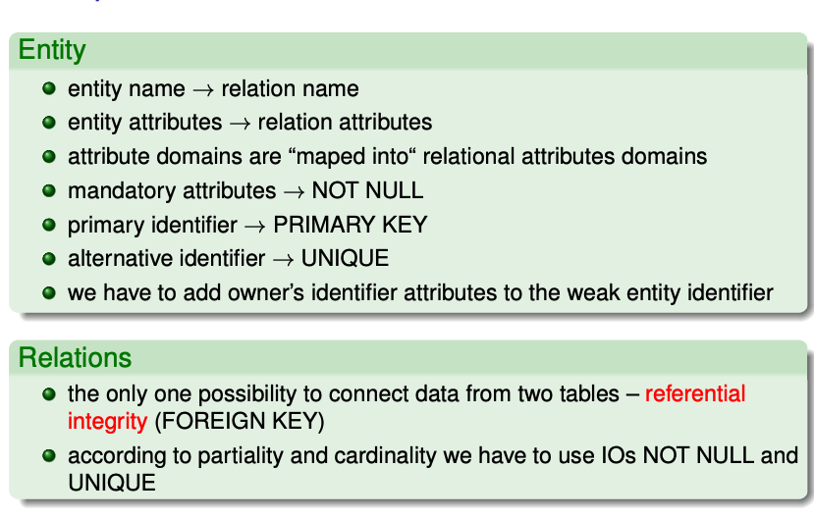
The transformation procedure

Slide 12
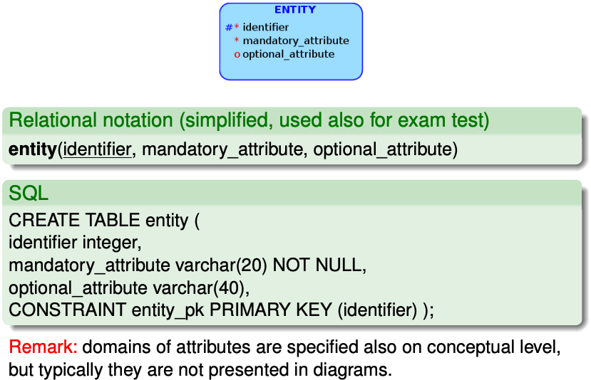
Strong entity implementation

Slide 13
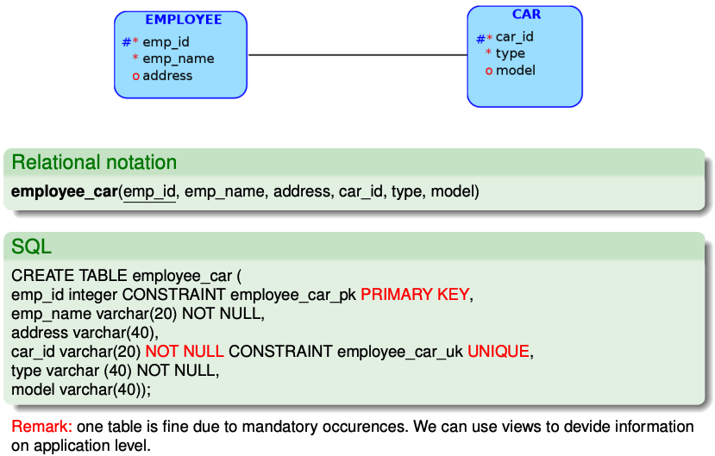
Relationship 1:1 - both entities mandatory participation

Slide 14
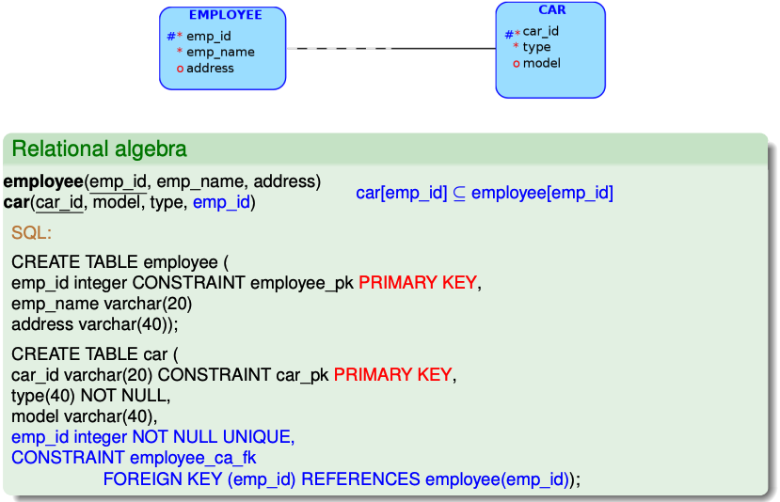
Relationship 1:1, one entity mandatory occurrence

Slide 15
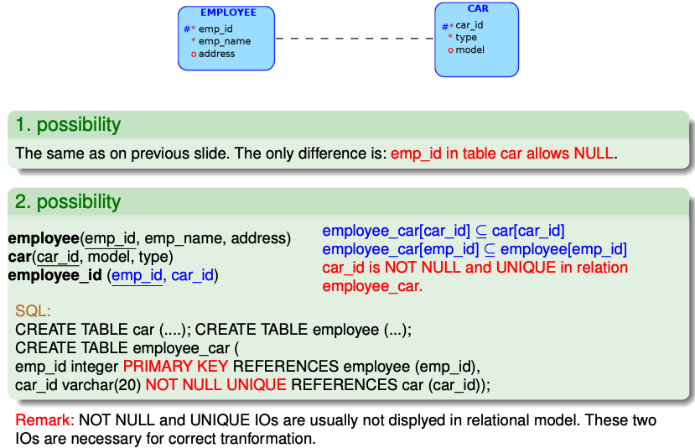
Relationship 1:1, optional occurrences

Slide 16
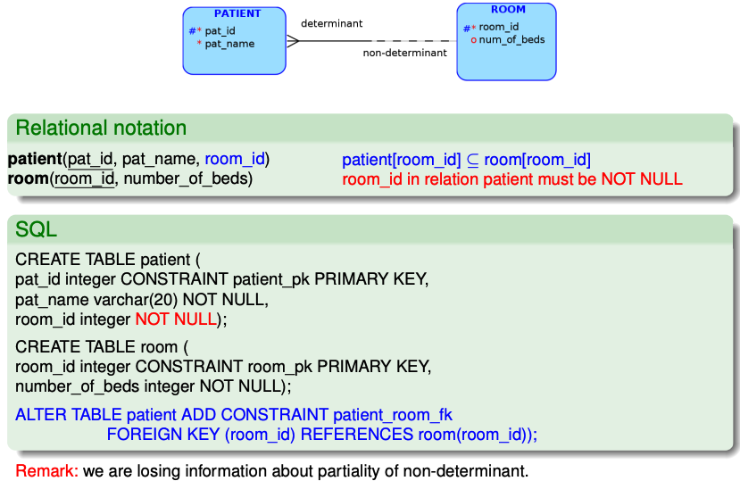
1:N, mandatory occurrence of determinant

Slide 17
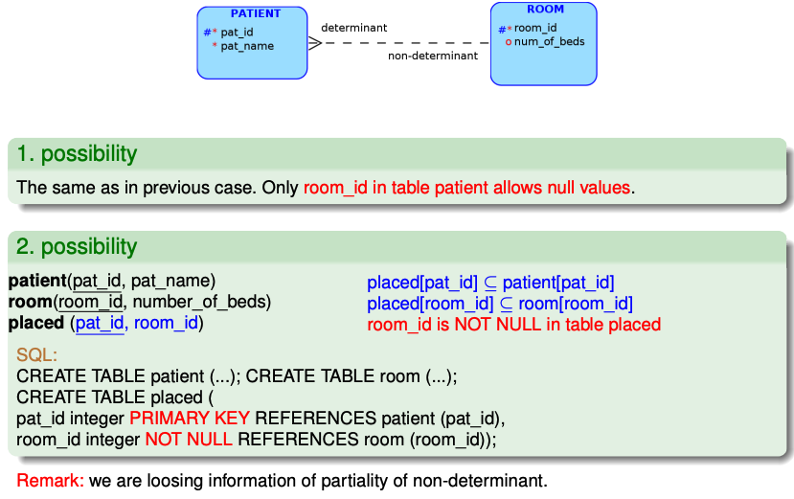
1:N, optional occurence of determinant

Slide 18
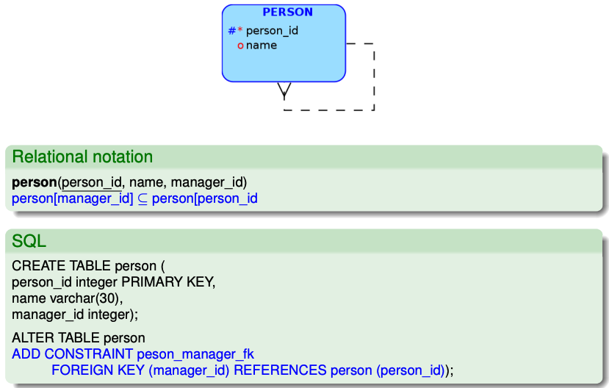
Recursive relationship

Slide 19
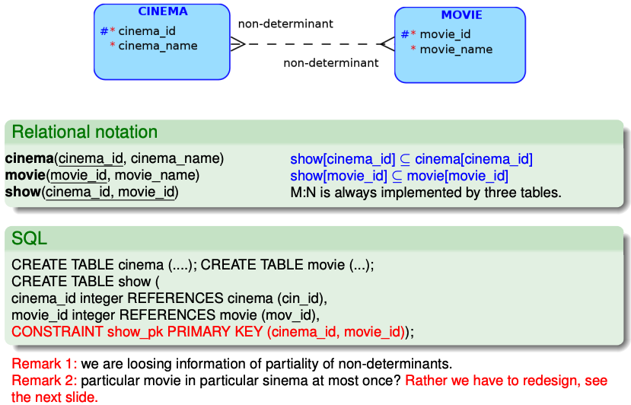
Relationship M:N

Slide 20
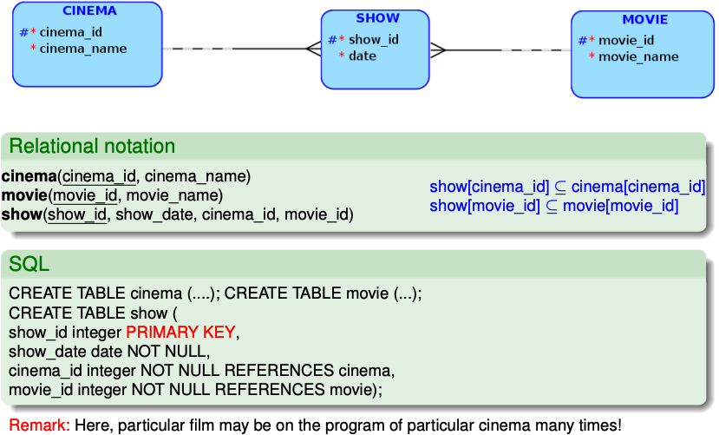
M:N – decomposition using strong entity

Slide 21
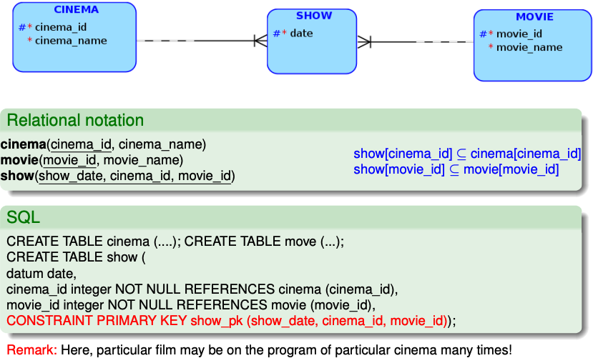
Relationship M:N – decomposition using weak entity

Slide 22
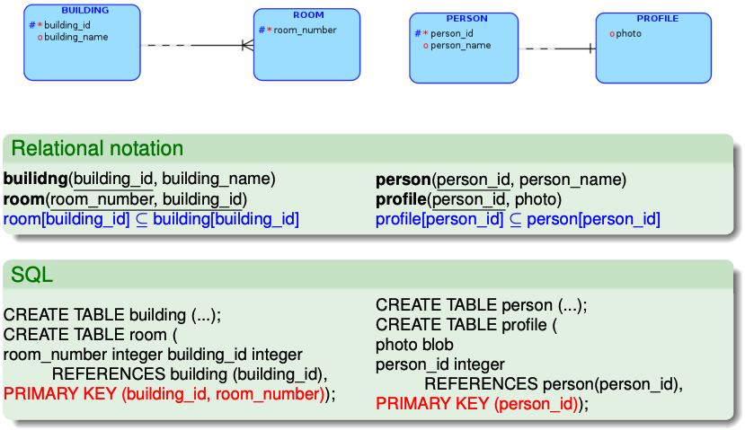
Weak entity, identification dependency

Slide 23
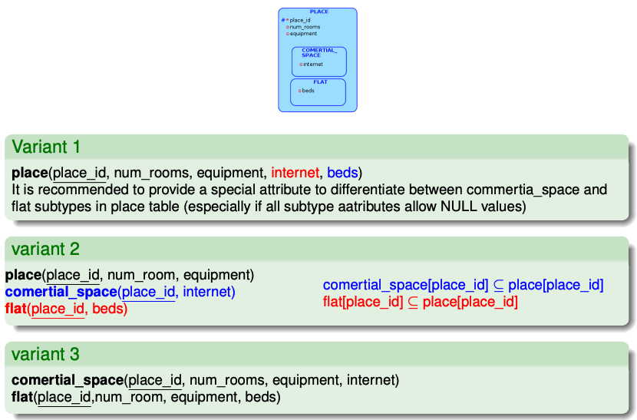
ISA hierarchy

Slide 24
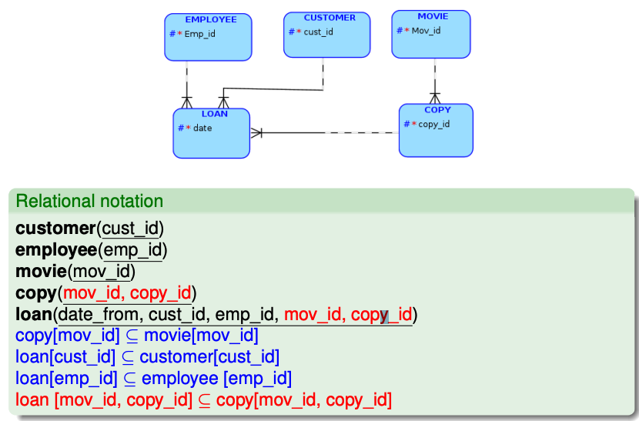
Key migration with ident. dept. and compound identifier

Slide 25
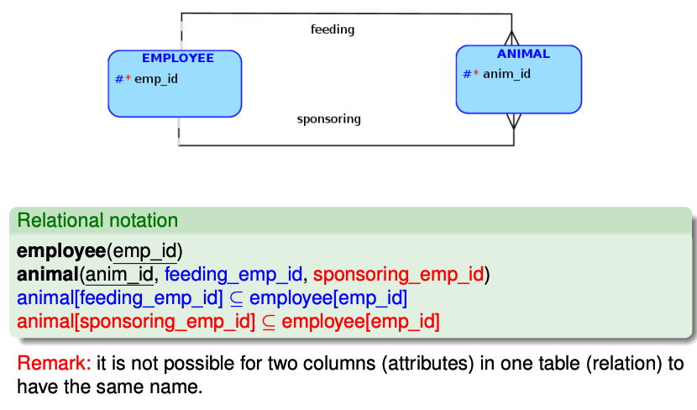
Possible problems with ER cycles in SQL

Slide 26
To be remembered
E-R constructs (entities (strong, weak) and relations(general, identification, exclusive, ISA ) and their IC (identifiers, obligations attribute, cardinalities, partialities) are expressed in the relational model (hence in SQL) using relations (tables) and combinations of its ICs (PRIMARY, UNIQUE, FOREIGN, NOT NULL, CHECK).
SQL syntax allows to name ICs. In practice, this is useful.
Even though (binary) E-R is a simple notation, we have in the transformation sometimes we have more options and sometimes we are not able to transform completely faithfully (we lose some information).
Modeling tools and gen. SQL tools are configurable. To set it up correctly, the transformation must be understood. Optimal variant also depends on the way the DB is queried. It is a "skill" (science) :-).
Loops (cycles) in the conceptual schema may not be wrong. Sometimes they cannot be avoided. You need to be able to interpret the loop and decide if it's justified. If there is a risk of inconsistency, additional ICs can be added.

